Slide 1

Ophthalmology/Retina
Diabetic Retinopathy:
Review or Refer?
Retina/Nonpromo/DME/IN2109137116/26-08-2023

Slide 2

Disclaimer
“The views, opinions, ideas etc expressed therein are solely those of the author. Novartis does not certify the accuracy, completeness, currency of any information and shall not be responsible or in anyway liable for any errors, omissions or inaccuracies in such information. Novartis is not liable to you in any manner whatsoever for any decision made or action or non-action taken by you in reliance upon the information provided. Novartis does not recommend the use of its products in unapproved indications and recommends to refer to complete prescribing information prior to using any of the Novartis products.”
Information is not shared with an intent to generate prescription

Slide 3
Content
1
Prevalence of Diabetic retinopathy in Diabetes Capital of world
4
Screening and Referral Criteria
for DR
2
DR and DME: Factors to look for
5
Treatment of DR/DME
3
Landscape of Diabetic Eye Disease
6
Summary

Slide 4
Prevalence of Diabetic retinopathy in Diabetes Capital of world

Slide 5
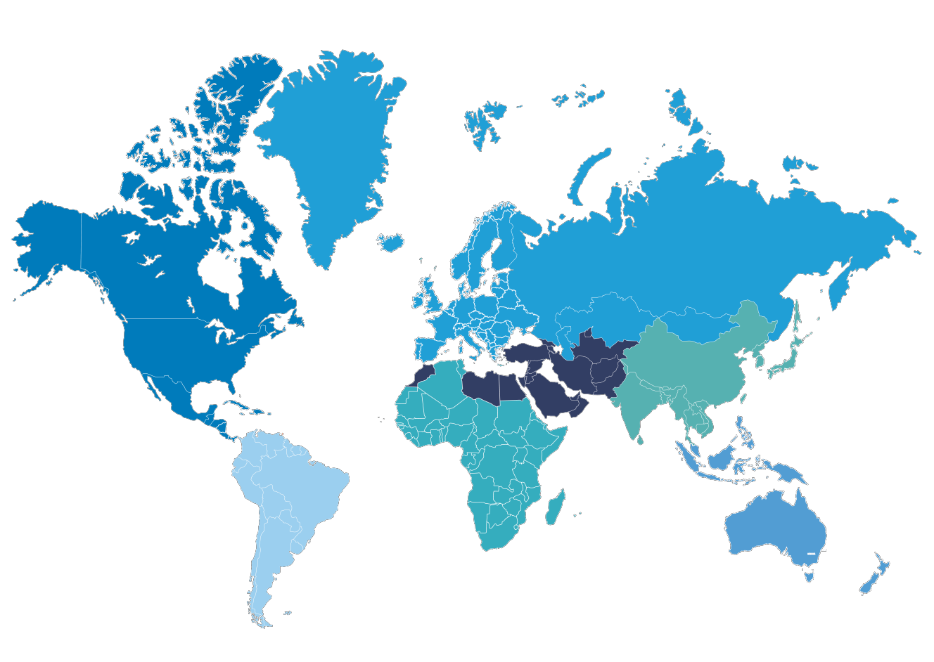
Diabetes: growing worldwide epidemic, affects working age population
Millions of cases in 2019 (prevalence) Millions of cases in 2045 (prevalence)* % increase
~51% global increase by 2045
North America and Caribbean
South-East Asia
South & Central America
87.6 (8.8%)
152.8 (11.3%)
+74%
Middle East & North Africa
Africa
Europe
Western Pacific
73 million affected by diabetes in India and expected to double 134 million in 2045
*Projections for adults aged 20-79 years.
Map not drawn according to scale and geopolitical borders
International Diabetes Federation. Diabetes Atlas 9th Edition, 2019, Oberoi S et al, Int J Diabetes Dev Ctries.2020; 06:1-12

Slide 6

Burden of Diabetes in India
Billion USD
In India, USD 92 was spent per diabetic patient
Spending
8.4% of total health expenditures was allocated to diabetes
This is data represent SEA region-South east Asia
International Diabetes Federation. Diabetes Atlas 9th Edition, 2019

Slide 7
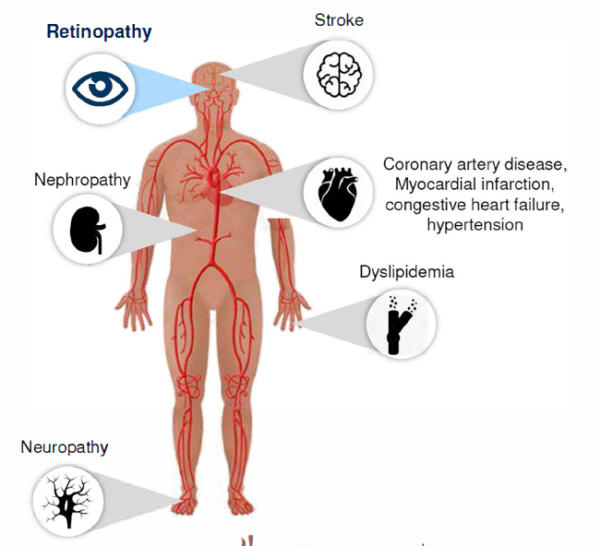
DR is vision threatening complication of diabetes^{1,2}
Diabetic comorbidities
DIABETES
(type 1 or type 2)
Microvascular
complications: Damage to the small blood vessels (microvasculature) of the body
Elevated blood glucose
High blood pressure
Other risk factors
1.Donnelly R, et al. BMJ. 2000;320: 1062-1066.
2.Eshaq RS, et al. Pathophysiology. 2017; 24(4): 229-241.

Slide 8
Loss of vision is the most feared complication of diabetes
Feelings about complications at diagnosis:
63% knew these health problems might affect them in the future, but risk seemed remote
25% were devastated they might develop complications
9% were not
really concerned
3% None of these
50%
21%
11%
10%
9%
7%
Complications patients were most concerned about:
Problems with vision/loss of sight/retinopathy
Heart/cardiac disease
Kidney/renal problems
Circulation problems
Problems with feet/legs
Other
Strain WD, et al. Diabetes Res Clin Pract 2014;105:302-12.

Slide 9





Diabetic Retinopathy disease burden
DR is the leading cause of blindness in working-age adults in the developed countries^{1,2}
PDR and DME develop as the
vision-threatening stages of DR (VTDR)^{1,2}
Age-standardized prevalence* (%)¹
11.72
VTDR
Extrapolating
these prevalence rates to the world diabetes population¹
92.6 mil Any DR
7.48
DME
17.2 mil
PDR
20.6 mil
DME
28.4 mil
VTDR
35.36
Any DR
7.24
PDR
Prevalence of DR in India, ~20 to 25% on basis of various population-based studies.³⁻⁶
*In diabetic patients DME, diabetic macular edema; DR, diabetic retinopathy; mil, millions; PDR, proliferative DR;VTDR, vision threatening DR
1. Yau JW, et al. Diabetes Care 2012;35:556–64; 2.Tremolada G, et al. Exp Diabetes Res 2012:728325 3.Kulkarni S et al. BMJ open ophthalmology. 2019 Feb 1;4(1):e000201. 4. Gadkari SS et al. Indian journal of ophthalmology. 2016 Jan;64(1):38. 5. Bhutia KL et al. Journal of Delhi Ophthalmological Society. 2017 Nov 30;28(2):19-21. 6. Rema M et al. Investigative ophthalmology & visual science. 2005 Jul 1;46(7):2328-33.

Slide 10
DR and DME: Factors to look for

Slide 11
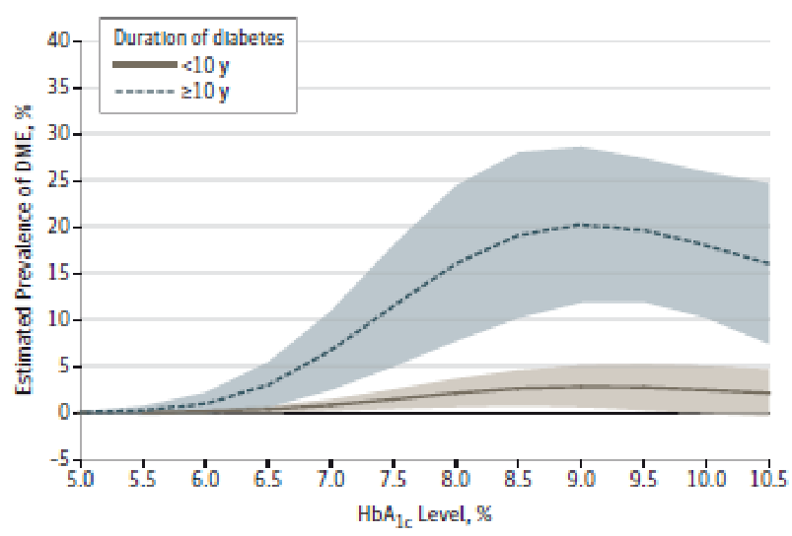
Risk factors for DME and DR¹
Modifiable
Non -modifiable
DR DME
Diabetes duration | + + + | + + +
Ethnicity | + + | + +
Puberty | + + | + +
Pregnancy | + + | + +
DR DME
Hyperglycemia (HbA1c) | + + + |  | +
Hypertension | + + | +
Dislipidemia | +
Inflammation | + |  | +
Overweight/ Obesity | + | +
HbA1c and diabetes duration have a higher influence on the prevalence of DME²
DME, Diabetic macular edema; DR, diabetic retinopathy; HbA1c, Hemoglobin A1c
1. Ding J, et al. Curr Diab Rep 2012;12(4):346-54; 2. Varma R, et al. JAMA Ophthalmol 2014;132:1334-40.

Slide 12
DR is the herald of diabetic complications^{1,2}
The presence of DR means that microcirculation is already damaged by the diabetic mellitus
The DCCT/EDIC Research Group showed that HbA1c values explained up to 11% of the risk of DR
DR is a reliable biomarker of the deleterious effects of diabetes in a specific individual
A subset of patients with poor control of glycemia and/or uncontrolled blood pressure do not develop DR
On the other hand, there are patients with very good control of blood glucose levels and without hypertension that will develop DR
Personalized medicine
DCCT, Diabetes Control and Complications Trial; DME, Diabetic macular edema; DR, diabetic retinopathy; EDIC, Epidemiology of Diabetes Interventions and Complications Study; HbA1c, Hemoglobin A1c
1. Diabetes 1995;44:968-983; 2. Lachin et al. Diabetes 2008;57:995-1001.

Slide 13

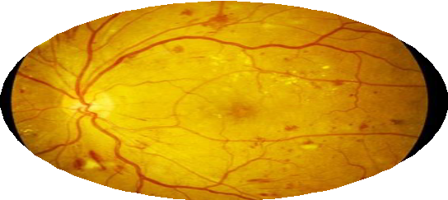



Presence and degree of Diabetic Retinopathy is significant risk factor of CV diseases and with (OR higher than) classic risk factors
Subset of population in which the screening of CV disease should be prioritized
Coronary artery disease¹
Stroke³
Heart Failure²
CV mortality⁴
Image courtesy: Prof. Rafael Simó
CV, cardiovascular; DR, diabetic retinopathy; HbA1c, Hemoglobin A1c
1. Cheung et al.Diabetes Care 2007;30(7):1742-1746; 2. Cheung et al.J Am Coll Cardiol.2008;51(16):1573-1578; 3.Cgeung et al.Stroke 2007;38(2):398-401;4.Juutilainen et al.Diabetes Care 2007;30(2):292-299

Slide 14
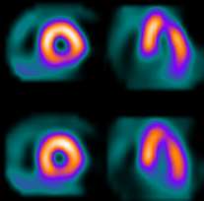

Myocardial perfusion defects in the absence of both angina and ST-segment depression during the exercise test
Prevalence: 10-fold higher (24.4 vs. 2.4%; p<0.01) in T2DM than in nondiabetic controls matched by age and gender
The presence of diabetic retinopathy was independently associated with the presence of defects in myocardial perfusion
DR
Odds ratio 11.7
[CI95%: 3.7-37]
Positive
SPECT
Image courtesy: Prof. Rafael Simó
DR, diabetic retinopathy; T2DM, type 2 diabetes mellitus
Gong Su et al. Cardiovasc Diabetol 2011; 21(1):9

Slide 15
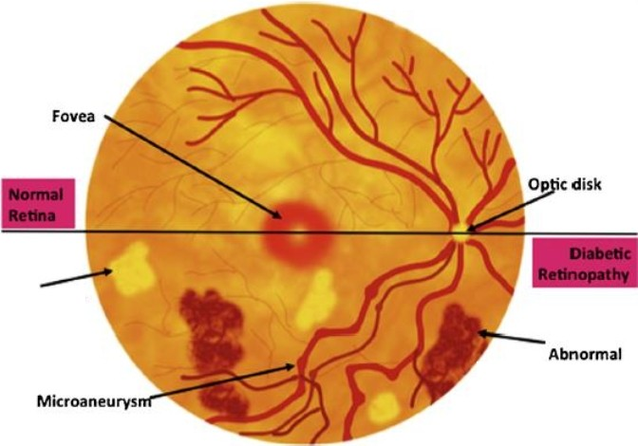
Types of blood vessel abnormalities in DR
Microaneurysms:
small balloon-like swellings in the capillaries
Microhemorrhages:
minor leakage of blood from damaged vessels
Cotton-wool spots:
oxygen-deficient areas caused by lost capillary function
Neovascularization:
VEGF-A triggers abnormal new blood vessel growth in response to the damage
A hallmark sign of PDR
New vessels are fragile and highly prone to hemorrhages (bleeding)
Early DR
"Cotton wool"
Spots
neovascularization
with hemorrhage
Advanced
DR
Eshaq RS, et al. Pathophysiology. 2017;24:229-41

Slide 16
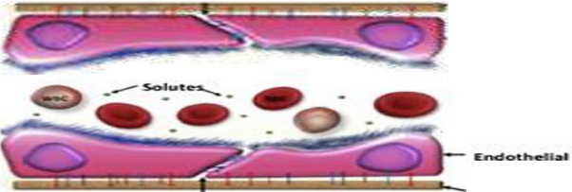
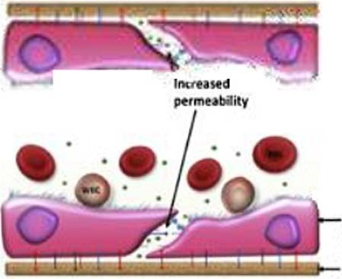
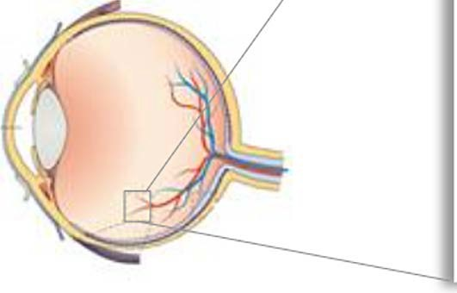
Diabetes and vision loss (1/2)
The blood-retinal barrier (BRB) is a wall of tightly joined cells separating the capillaries from the interior of the retina¹
In DR, the sustained high blood sugar of diabetes causes the BRB to rupture, leading to leaky blood vessels^{1,2}
Normal retinal blood vessel
Diabetic retinopathy
....
lndotliollol celh
lnement mernbtartt
.,.....,.,,.
Endotht..l ctl Junction
lbsament
Blood vessel breakdown in DR is mediated by VEGF-A^{1,3}
Eshaq RS, et al. Pathophysiology. 2017; 24(4): 229-241.
Romero-Aroca P. J Diabetes Res. 2016; 2016: 2156273.
Bahrami B, et al. Asia Pac J Ophthalmol (Phi/a). 2017; 6(6): 535-545.

Slide 17
Landscape of Diabetic Eye Disease

Slide 18
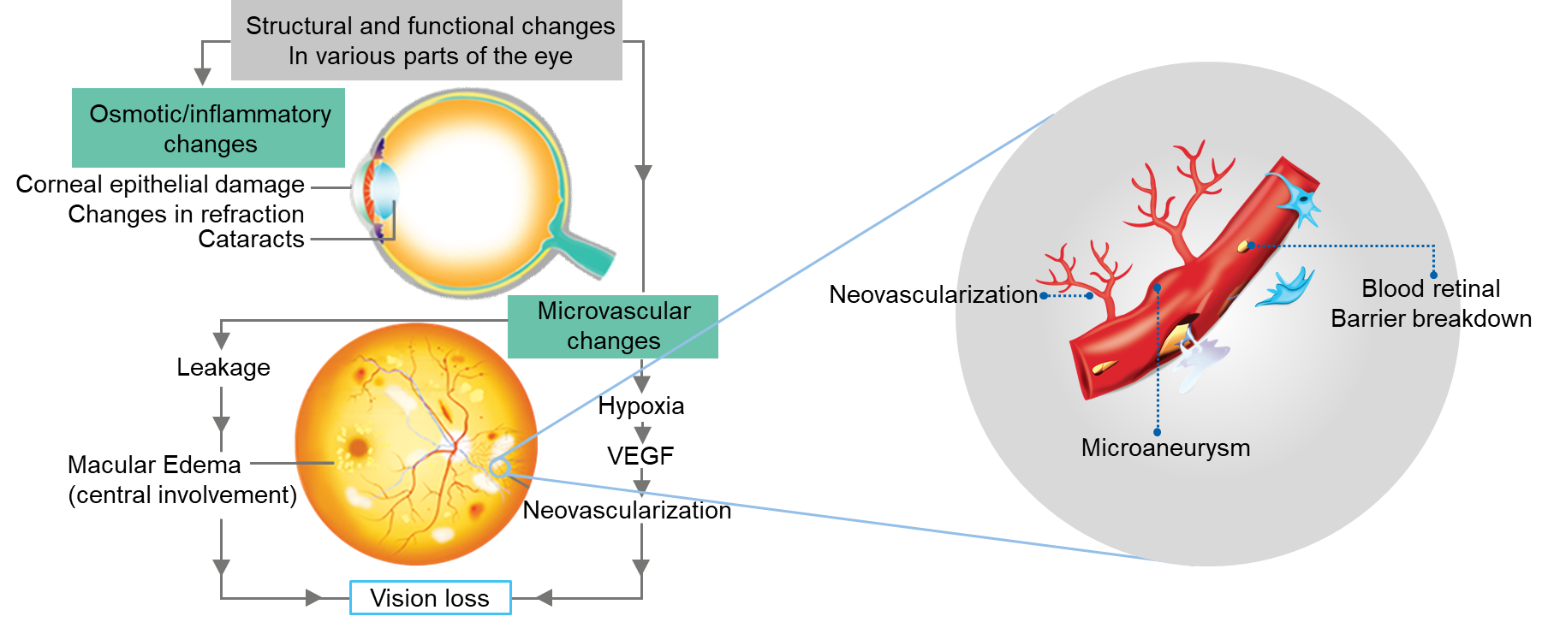
Diabetes and vision loss
VEGF is major factor involved in pathophysiology of Diabetic Macular Edema and Proliferative Diabetic Retinopathy
Das A. Invest Ophthalmol Vis Sci. 2016;57:6669–82

Slide 19
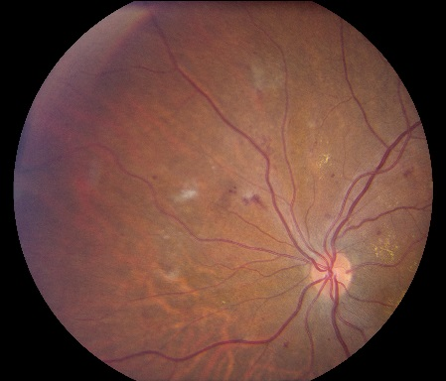
Stages of Diabetic Retinopathy^{1,2}
Mild non-proliferative
Earliest stage of disease
Small areas of balloon-like swelling in the tiny blood vessels of the retina (microaneurysms)
DR, diabetic retinopathy
NEI. 2015: http://www.nei.nih.gov/health/diabetic/retinopathy.asp [accessed December 2015];
Wilkinson CP, et al. Ophthalmology 2003;110:1677-82.

Slide 20
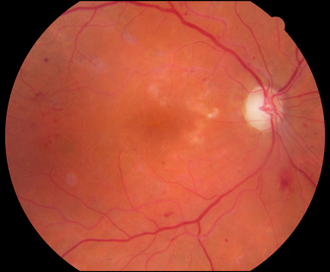
Stages of Diabetic Retinopathy^{1,2}
Mild non-proliferative
Moderate non-proliferative
Earliest stage of disease
Small areas of balloon-like swelling in the tiny blood vessels of the retina (microaneurysms)
Swollen and distorted retinal blood vessels
Blood supply in the eye may be reduced
Possible blockage of vessels
DR, diabetic retinopathy
NEI. 2015: http://www.nei.nih.gov/health/diabetic/retinopathy.asp [accessed December 2015];
Wilkinson CP, et al. Ophthalmology 2003;110:1677-82.
20

Slide 21
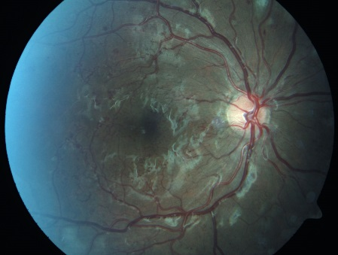
Stages of Diabetic Retinopathy^{1,2}
Mild non-proliferative
Moderate non-proliferative
Earliest stage of disease
Small areas of balloon-like swelling in the tiny blood vessels of the retina (microaneurysms)
Severe non-proliferative
Swollen and distorted retinal blood vessels
Blood supply in the eye may be reduced
Possible blockage of vessels
Increased numbers of retinal blood vessels are blocked
Deprived blood supply to areas of the retina leads to the release of growth factors that stimulate growth of
new blood vessels
More significant damage in retina
DR, diabetic retinopathy
NEI. 2015: http://www.nei.nih.gov/health/diabetic/retinopathy.asp [accessed December 2015];
Wilkinson CP, et al. Ophthalmology 2003;110:1677-82.

Slide 22
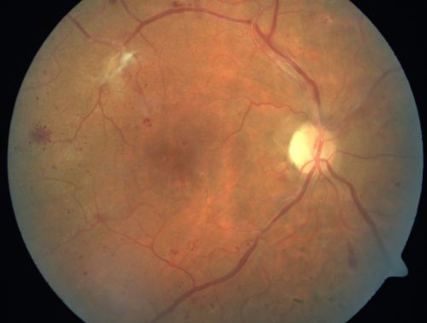
Stages of Diabetic Retinopathy^{1,2}
Mild non-proliferative
Moderate non-proliferative
Earliest stage of disease
Small areas of balloon-like swelling in the tiny blood vessels of the retina (microaneurysms)
Severe non-proliferative
Swollen and distorted retinal blood vessels
Blood supply in the eye may be reduced
Possible blockage of vessels
Proliferative
Increased numbers of retinal blood vessels are blocked
Deprived blood supply to areas of the retina leads to the release of growth factors that stimulate growth of
new blood vessels
More significant damage in retina
Growth factors released by the retina
Growth factors stimulate the growth of new and fragile
blood vessels
Fragile blood vessels are ‘leaky’ – fluid builds up
Scar tissue formation and increased risk of retinal detachment
May result in permanent vision loss
DR, diabetic retinopathy
NEI. 2015: http://www.nei.nih.gov/health/diabetic/retinopathy.asp [accessed December 2015];
Wilkinson CP, et al. Ophthalmology 2003;110:1677-82.

Slide 23
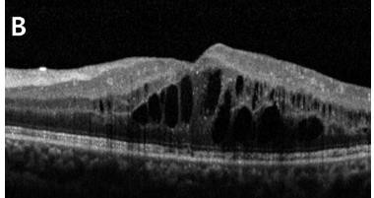
Diabetic Macular Edema
Retinal thickening
DME can occur at any stage of
diabetic retinopathy.¹
RPE layer
Deposits of fat from the blood prevent the retina from functioning properly.³ These fatty deposits are a marker of advanced DME⁴
Choroid
Clinically Significant Macular Edema:
Retinal thickening within 500 µm of the macular center or hard exudates within 500 µm of the macular center
Leakage of fluid under the macula results in swelling (macular edema), which can cause blurred or distorted vision²
1. Klein R, et al. Ophthalmology 1984;91:1464-74; 2. RNIB. Diabetes-related eye conditions. 2014: http://www.rnib.org.uk/eyehealth/eyeconditions/eyeconditionsdn/Pages/diabetes.aspx [accessed
December 2015]; 3. Bhagat N, et al. Surv Ophthalmol 2009;54:1-32; 4. Schmidt-Erfurth U. et al ,A Clinical and Technical Update. New York: Springer 2012. p. 175-208.

Slide 24





Landscape of Diabetic Eye Disease
DR is a common, progressive microvascular complication of diabetes and is a precursor to DME and PDR¹
Non-proliferative DR (NPDR)
Proliferative DR (PDR)
Hard exudates
Edema
Mild
Moderate
Severe
Characterized by microaneurysms only
There are other IRMAs in addition to microaneurysms
When widespread intraretinal hemorrhages and microaneurysms are observed
Characterized by retinal neovascularization
New blood vessels are likely to be fragile and may be easily ruptured
While DME may occur at any stage of DR, it is more likely to manifest following severe NPDR²
Vision threatening
Eshaq RS, et al. Pathophysiology. 2017;24:229–41
Klein R, et al. Arch Ophthalmol. 2001;119:547–53

Slide 25
Clinical features of Diabetic Retinopathy

Slide 26
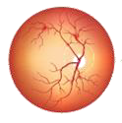
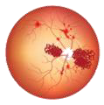
Clinical features and complications
~50% of people with very severe NPDR progress to PDR within 1 year and 25% of patients have PDR at 15 years of diabetes duration1,2
Non-proliferative DR (NPDR)
NPDR¹
PDR^{1,3}
Microaneurysms
Intra-retinal hemorrhages
Vascular changes
Hard exudates (lipid deposits)
Soft exudates or cotton wool spots
Intra-retinal microvascular
Abnormalities (IRMA)
Retinal edema
Neovascularization with
possible complications:
Vitreous hemorrhage
Fibrosis
Vitreous or retinal detachments
Neovascular glaucoma
Martinez-Zapata MJ, et al. Cochrane Database Syst Rev 2014;11:CD00872
Fong DS, et al. Diabetes Care 2004;27:584–7
Tremolada G, et al. Exp Diabetes Res 2012:728325

Slide 27
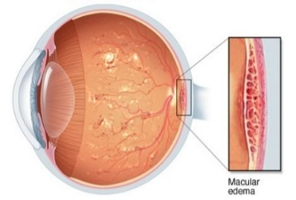



PDR and DME can cause vision loss^{1,2}
NPDR
PDR
DME
PDR and DME can cause severe vision loss and decrease quality of life
Vision threatening
Martinez-Zapata MJ, et al. Cochrane Database Syst Rev 2014;11:CD00872
Fong DS, et al. Diabetes Care 2004;27:584–7
Tremolada G, et al. Exp Diabetes Res 2012:728325

Slide 28

Diagnosis
Diagnostic Methods
1
Fundus Photography
Plays a central role in DR/DME diagnosis
DR is diagnosed clinically on the basis of visible hemorrhages, microaneurysms, cotton wool, spots, lipid exudates, and neovascularization
2
Optical Coherence Tomography
To diagnose and monitor progression of DR/DME
3
Fluorescein Angiography
Identifying areas of capillary nonperfusion
4
Blood Investigations HbA1C,Hemoglobin level, Renal function, urine protein, Lipid levels Blood pressure
        https://eyewiki.aao.org/Diabetic Macular Edema#Medical therapy
        https://www.aao.org/eye-health/diseases/macular-edema-diagnosis
        Mareeen et al, Kerala Journal of Ophthalmology, 2013,25 (4),335-341

Slide 29
Screening and Referral Criteria for Diabetic Retinopathy

Slide 30

Screening
Who should Screen?
1
Ophthalmologist, Physician, Optometrist/Ophthalmic assistant: Who have skill of screening of DR Any field level worker
How to Screen?
2
Indirect Ophthalmoscopy, Slit-lamp bio microscopic examination, Dilated Direct Ophthalmoscopy, Non-Mydriatic photography, Mydriatic photography, Handheld Fundus camera
Whom to screen?
3
People with Known diabetes. (Annual screening recommended)
Opportunistic screening: Screening for all patients attending clinic
Mass Screening: Having specific camps for DR screening
Vision 2020: Right to Sight India Guidelines for Diabetic Eye Care,2015

Slide 31

Screening Criteria for Diabetic Retinopathy
Diabetes History; Medical History; Current Medication; Biochemical parameters
Uncorrected Visual Acuity VA with current Spectacles
Ophthalmoscopy or Fundus Photography
VA better than 6/12 (20/40)
VA 6/12 (20/40) or worse
Diabetic Retinopathy*
None
Mild or Moderate NPDR
Severe NPDR, DME, or PDR
Routine re-examination
Non-urgent Referral for refraction and assessment
Urgent Referral
* Need to optimize medical treatment; glycemic control, hypertension and lipids.
ICO Guidelines for Diabetic Eye Care, 2017

Slide 32
Follow up recommendations
Type of Diabetic Retinopathy
Frequency
None
Every year
Mild
Every 6-12 months
Moderate
Every 6 months*
Severe
Every 3 months*
PDR
Every 3 months
Non‑CiDME (non‑center DME)
Every 3 months
Centre involving DME (CiDME)
Every 1‑2 months
*more frequently for those with poor glycaemic control or other risk factors.
Raman R, et al,Indian J Ophthalmol 2020;0:0.

Slide 33
Treatment of Diabetic Retinopathy/Diabetic Macular Edema

Slide 34

Treatment
NPDR
PDR
DME
Risk factor control to manage blood glucose, blood pressure¹
Panretinal photocoagulation (laser treatment) shrinks and scars up the damaged blood vessels²
Anti-VEGF therapy showed efficacy and safety in patients with PDR ²
Anti-VEGFs to counteract the key disease driver VEGF-A
Focal/grid laser treatment
lntraocular steroid treatment
Treatmentavailable
Goal of treatment
Prevent development or progression of DR and DME
Prevent further loss of vision rather than restoring diminished VA^{1,3}
Maximize vision gains and maintain gains over the long term
Vision threatening
1. Park YG, Roh YJ. J Diabetes Res. 2016:1753584 2. Zhao Y, Singh RP. Drugs Context. 2018;7:212532 3. Duh EJ, et al. JCI Insight. 2017; 2:pii: 93751. 4.Bahrami B, et al. Asia PacJ Ophthalmol (Phi/a). 2017; 6(6): 535-545.

Slide 35
Clear communication is needed between ophthalmologist's and diabetologists to optimize care
Health care professionals from different disciplines need to be fully aware of all aspects of the patient’s care to ensure effective and appropriate treatment for DR/DME
1
2
3
4
Providing complete patient notes and ensuring patient follow-up
Reinforcing targets to reduce development
of CSME e.g. HbA_{1c}<7% and BP <120/80 mm Hg
Review of systemic treatments following DME diagnosis along with potential risks associated with VEGF suppression
Consistent communication to patients about lifestyle modifications and
diabetes management
35
CSME, clinically significant macular edema; DME, diabetic macular edema

Slide 36
Summary
1
DR is a complication of diabetes caused by damage to the small vessels of the retina
2
Patients with severe NPDR, PDR and DME require immediate referral to Ophthalmologist
3
Annual eye screening for diabetes patient highly recommended.
4
Treatment of DR/DME requires a multifactorial and multidisciplinary approach: Systemic treatment and ocular treatment
5
Clear communication between Diabetologist & Retinologist is essential to optimize the patient care
36
36

Slide 37
Thank You

