Slide 1
Unmet Medical Needs in Diabetic Macular Edema
Retina/Nonpromo/DME/IN2109137116/26-08-2023

Slide 2
Disclaimer
The content of this slide deck is accurate to the best of our knowledge at the time of production, but accuracy and context at the time of presentation is the responsibility of the presenter.
This presentation is intended for non-promotional scientific purposes only and may contain information on products or indications currently under investigation and/or that have not been approved by the regulatory authorities.\
Any data about non-Novartis products are based on publicly available information at the time of presentation.
Novartis does not recommend the use of its products in unapproved indications and recommends to refer to complete prescribing information prior to using any of the Novartis products.
Novartis is not liable to you in any manner whatsoever for any decision made or action or non-action taken by you in reliance upon the information provided.
Information is not shared with an intent to generate prescription.
Please note that the recording, reproduction, distribution including on social media, public communication and/or content modification are not allowed. The content is Novartis Pharma proprietary and copyrighted content.

Slide 3
Diabetic Macular Edema Disease Burden

Slide 4
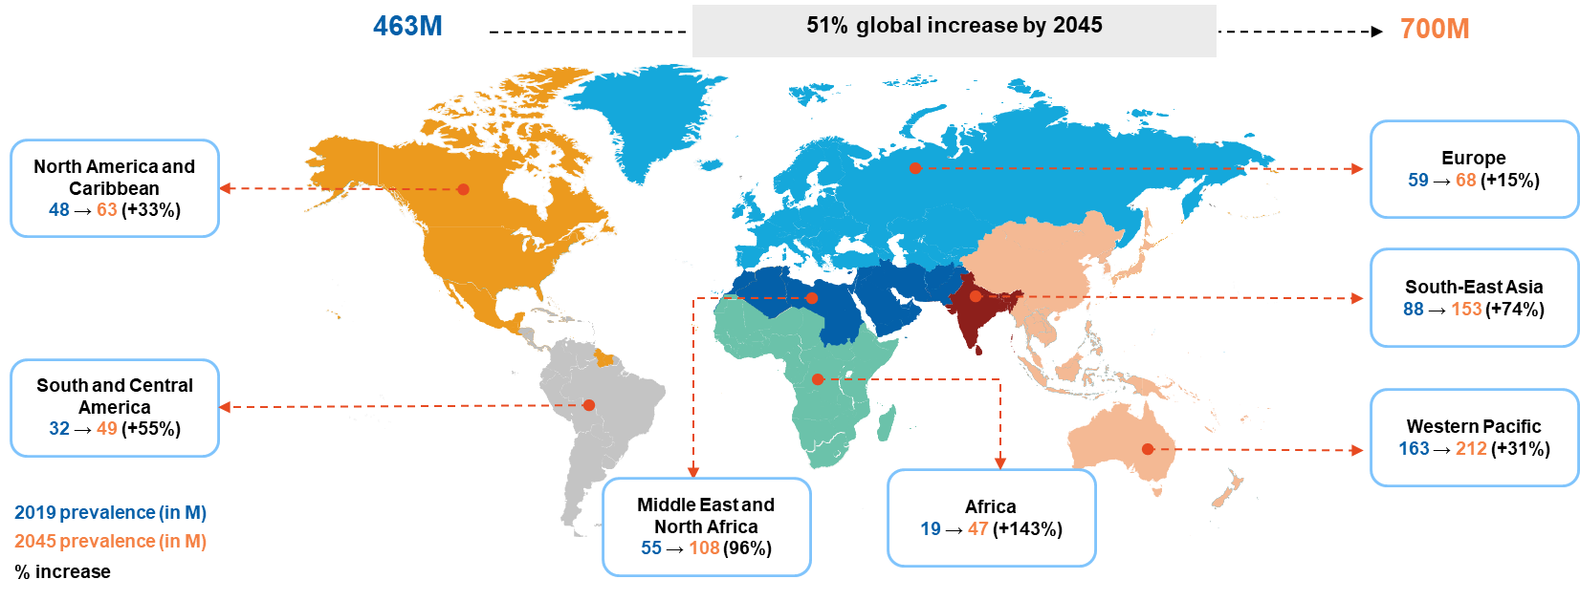
Diabetes is a growing worldwide epidemic, mostly affecting the working-age population
Number of people with diabetes worldwide and per International Diabetes Federation region in 2019, 2030, and 2045 (age: 20–79 years); map not drawn according to scale or geopolitical borders.
M, million. International Diabetes Federation. Diabetes Atlas 9th Edition, 2019.
Notes:
001_Diabetes atlas 2019

Slide 5
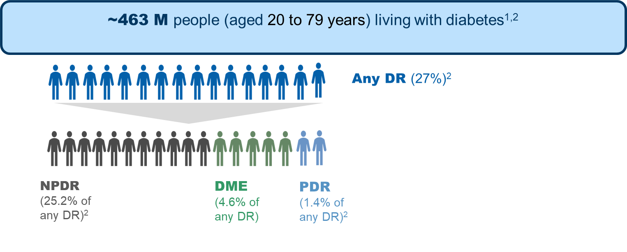
Disease burden of DR and DME: Complications in diabetic patients
DME, diabetic macular edema; DR, diabetic retinopathy; NPDR, nonproliferative diabetic retinopathy; PDR, proliferative diabetic retinopathy.
1. International Diabetes Federation. Diabetes Atlas. 9th ed. 2019; 2. Thomas RL et al. Diabetes Res Clin Pract. 2019 Nov;157:107840. doi: 10.1016/j.diabres.2019.107840.
Notes:
001_Diabetes atlas 2019
002_Thomas RL et al_2019

Slide 6
Unmet medical needs in DME from various perspectives

Slide 7
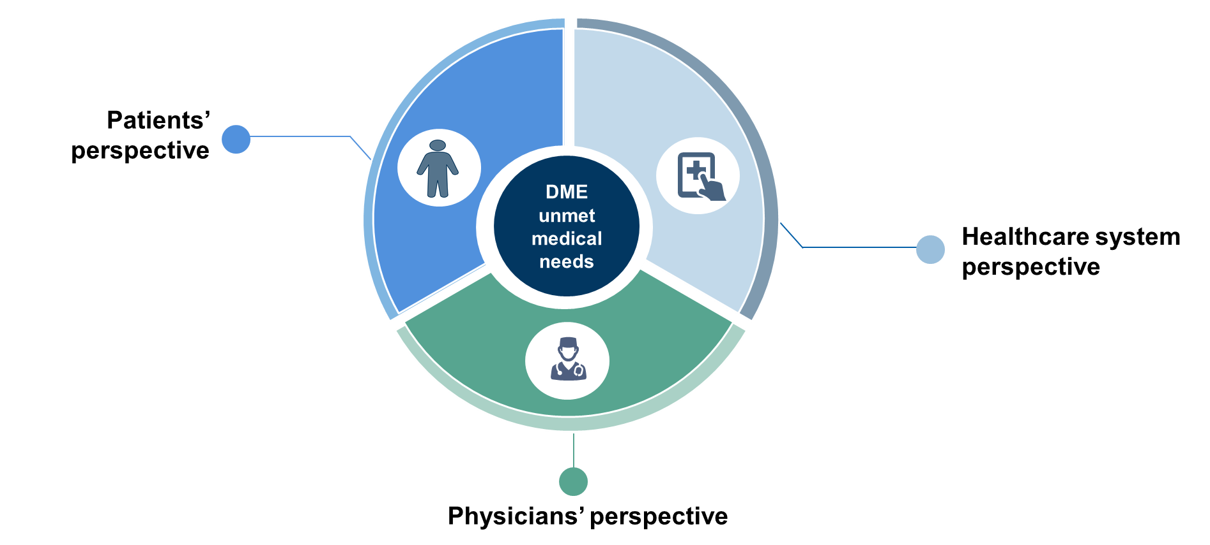
Unmet medical needs in DME from various perspectives
DME, diabetic macular edema.

Slide 8
Patients’ perspective

Slide 9
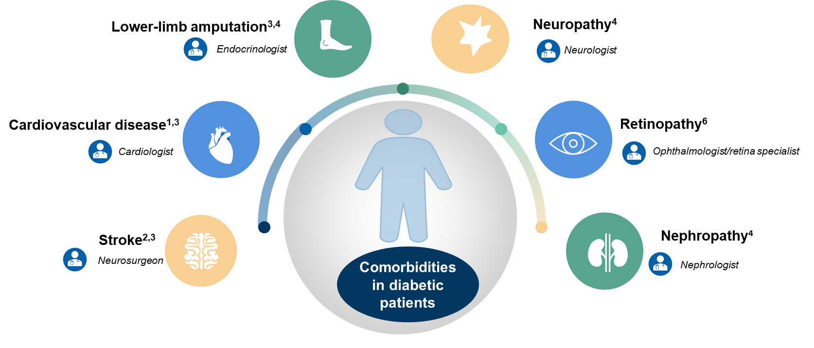
Diabetes-associated comorbidities involve multiple specialist visits, adding to treatment and monitoring burden
1. Centers for Disease Control and Prevention. Available at: http://www.cdc.gov/diabetes/pubs/pdf/ndfs_2011.pdf. Accessed October 29, 2019; 2. Long AN and Dagogo-Jack S. J Clin Hypertens 2011;13:244–51; 3. International Diabetes Federation. Diabetes Atlas 9th Edition, 2019; 4. Kosiborod M, et al. Cardiovasc Diabetol 2018;17:150; 5. Rowley WR, et al. Popul Health Manag 2017;20:6–12; 6. Li JQ, et al. Eur J Epidemiol 2019; doi: 10.1007/s10654-019-00560-z.
Notes:
003_Centers for Disease Control and Prevention 2011
004_Long AN_2011
001_Diabetes atlas 2019
005_Kosiborod M et al_2018
006_Rowley WR et al_2017
007_Li JQ et al_2019

Slide 10
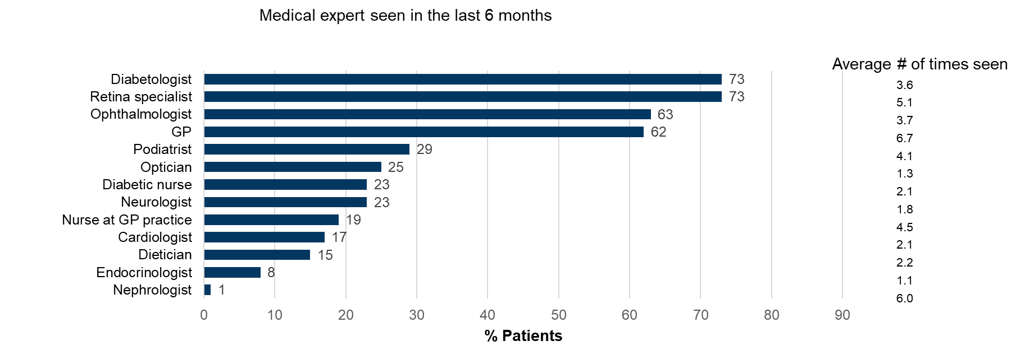
Patients with DME experience a high medical burden
Sivaprasad S, et al. Clin Ophthalmol. 2016;24;10:939-946.
Notes:
008_Sivaprasad S et al_2016

Slide 11
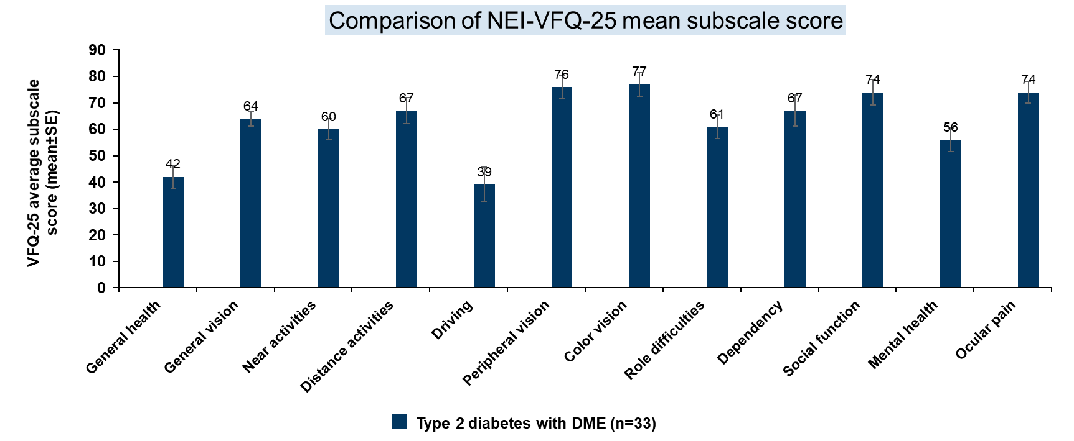
Patients with DME had significantly poor*scores in the Quality-of-life tests
*The DME group had significantly poorer scores versus the type 1 DR group (P<0.01) for 3 subcategories (based on 12 subscales) – general health, quality of vision, and vision-related quality of life. The t-test comparison with the DME treatment group was not statistically significant. DME, diabetic macular edema; DR, diabetic retinopathy; n, number of patients; NEI-VFQ-25, National Eye Institute 25-item Visual Function Questionnaire; SE, standard error. Hariprasad SM, et al. Br J Ophthalmol 2008;92:89–92.
Notes:
009_Hariprasad SM et al_2008

Slide 12
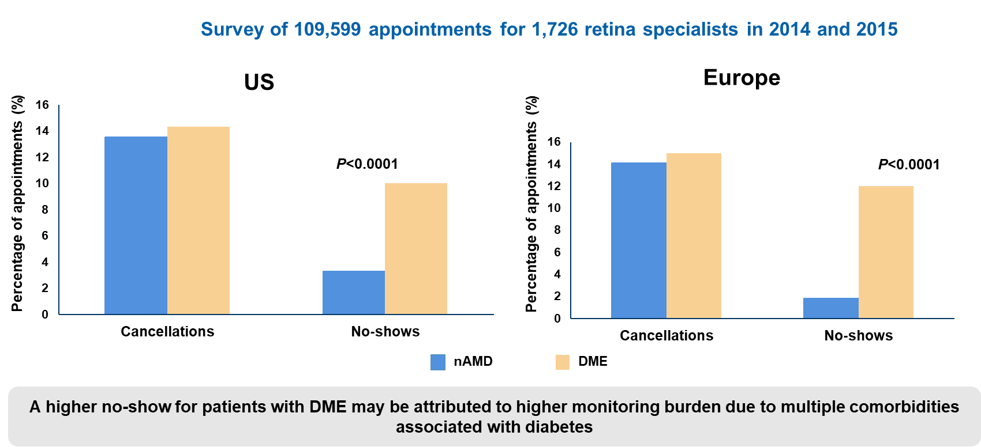
Patient compliance is low for DME compared with nAMD
DME, diabetic macular edema; nAMD, neovascular age-related macular degeneration; US, United States. Jansen ME, et al. Ophthalmic Surg Lasers Imaging Retina 2018;49:186–90.
Notes:
010_Jansen ME et al_2018

Slide 13
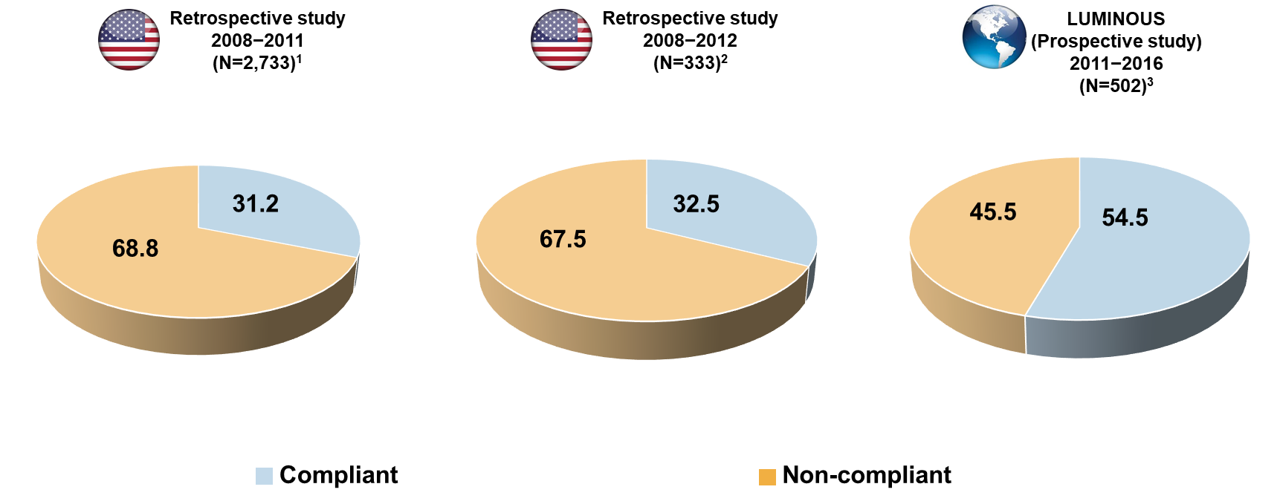
Treatment*compliance in patients with DME is low
*Anti-VEGF treatment. DME, diabetic macular edema; N, total number of patients; VEGF, vascular endothelial growth factor. 1. Kiss S, et al. Clinical Ophthalmol 2014;8:1611–21 [Compliant – Patients received 3 or more bevacizumab injections in the first 4 months of treatment]; 2. Jiang S, et al. J Manag Care Spec Pharm 2015;21:735–41 [Noncompliant – Patients with less than 3 treatments during the first-year of follow-up]; 3. Mitchell P, et al. Results presented at: EURETINA 2017 Congress; September 7–10, 2017; Barcelona, Spain [Compliant – Loading dose - 3 initial consecutive injections at 4 weekly intervals; LUMINOUS is a prospective, open-label, observational study].
Notes:
011_Kiss S et al_2014
012_Jiang S et al_2015
013_Mitchell P et al_2017

Slide 14
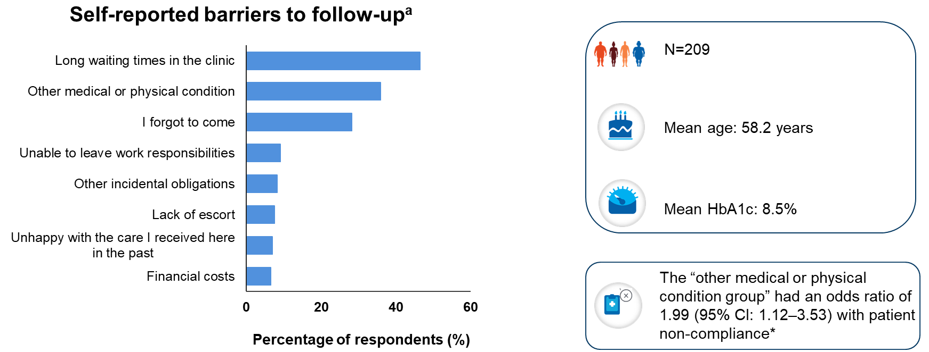
Comorbidities and loss of productive time are contributors to patient non-compliance
ªThe most common self-reported barrier to follow-up cited by patients was long waiting times in clinic (46.4% [97 of 209]), followed by other medical/physical conditions (35.9% [75 of 209]), forgot to come to clinic (28.2% [59 of 209]) and inability to leave work (9.1% [19 of 209]) *Noncompliance is defined as failure to attend ≥80% of the scheduled appointments or failure to reschedule missed or patient-canceled appointments within 1 month of the desired follow-up, with a reminder call. CI, confidence interval; HbA1c, glycated hemoglobin; N, total number of patients. Lu AJ, et al. Ophthalmic Surg Lasers Imaging Retina 2019;50:99–105.
Notes:
014_Lu AJ et al_2019

Slide 15
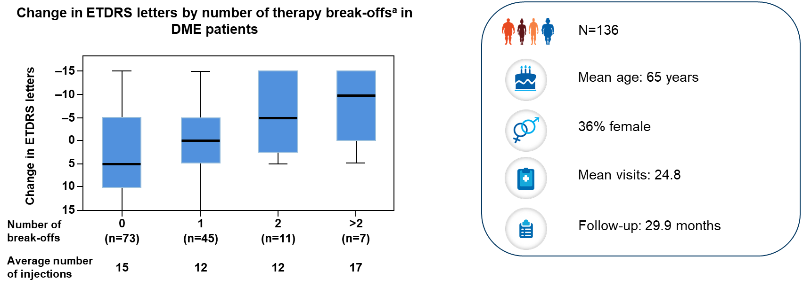
Treatment compliance directly affects VA gains in patients with DME
ªAbsence of more than 100 days of therapy was determined as a therapy break-off. DME, diabetic macular edema; ETDRS, Early Treatment Diabetic Retinopathy Study; N, total number of patients; n, number of patients; VA, visual acuity. Weiss M, et al. Retina 2018;38:2293–300.
Notes:
015_Weiss M et al_2018

Slide 16
Noncompliance results in a >10x higher rate of significant vision loss in the real world
Ehlken C, et al. Clin Ophthalmol. 2018;12:13-20.
Notes:
016_Ehlken C et al_2018

Slide 17
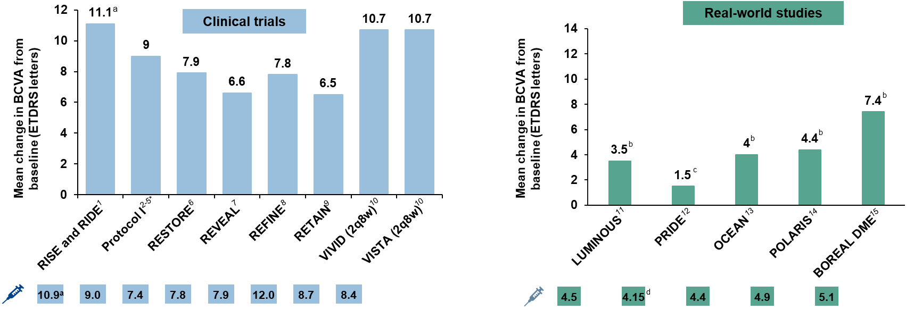
Real-world evidence shows poor visual outcomes with a smaller number of injections, indicating undertreatment
All values are presented as mean change in VA (ETDRS letters) from baseline for the respective studies. aPooled data for RISE and RIDE studies ( BCVA data at Month 12 for 0.5 mg ranibizumab and mean number of injections by first 12-month treatment); bData presented for month 12; cVA at month 5; dMean number of injections for study duration – month 18. *For ranibizumab 0.5 mg + deferred laser. For RETAIN, T&E data are included (month 24)*For ranibizumab 0.5 mg + deferred laser. For RETAIN, T&E data are included (month 24). BCVA, best-corrected visual acuity; ETDRS, Early Treatment Diabetic Retinopathy Study; T&E, treat-and-extend; VA, visual acuity; 2q8w, twice every 8 weeks. 1.Brown DM, et al. Ophthalmology 2013;120:2013–22; 2. Elman MJ, et al. Ophthalmology 2010;117:1064–77; 3. Elman MJ, et al. Ophthalmology 2011;118:609–14; 4. Elman MJ, et al. Ophthalmology 2012;119:2312–8; 5. Elman MJ, et al. Ophthalmology 2015;122:375–81; 6. Schmidt-Erfurth U, et al. Ophthalmology 2014;121:1045–53; 7. Ishibashi T, et al. Ophthalmology 2015;122:1402–159; 8. Li X, et al. Graefes Arch Clin Exp Ophthalmol 2019;257:529–41; 9. Prünte C, et al. Br J Ophthalmol 2016;100:787–95; 10. Korobelnik JF, et al. Ophthalmology 2014;121:2247–54; 11. Mitchell P, et al. Results presented at: EURETINA 2017 Congress; September 7–10, 2017; Barcelona, Spain; 12. Menchini U, et al. J Ophthalmol 2015. Article ID: 324841; 13. Ziemssen F, et al. Diabetes Ther 2018;9:2271–89; 14. Stefanickova J, et al. Acta Ophthalmol 2018;96:e942–e949; 15. Massin P, et al. Ophthalmic Res 2019;62:101–10.
Notes:
017_Brown DM et al_2013
018_Elman MJ et al_2010
019_Elman MJ et al_2011
020_Elman MJ et al_2012
021_Elman MJ et al_2015
022_Schmidt-Erfurth U et al_2014
023_Ishibashi T et al_2015
024_Li X et al_2019
025_Prunte C et al_2016
026_Korobelnik JF et al_2014
013_Mitchell P et al_2017
027_Menchini U et al_2015
028_Ziemssen F et al_2018
029_Stefanickova J et al_2018
030_Massin P et al_2019

Slide 18
Summary
DME, diabetic macular edema; VA, visual acuity.

Slide 19
Physicians’ perspective

Slide 20
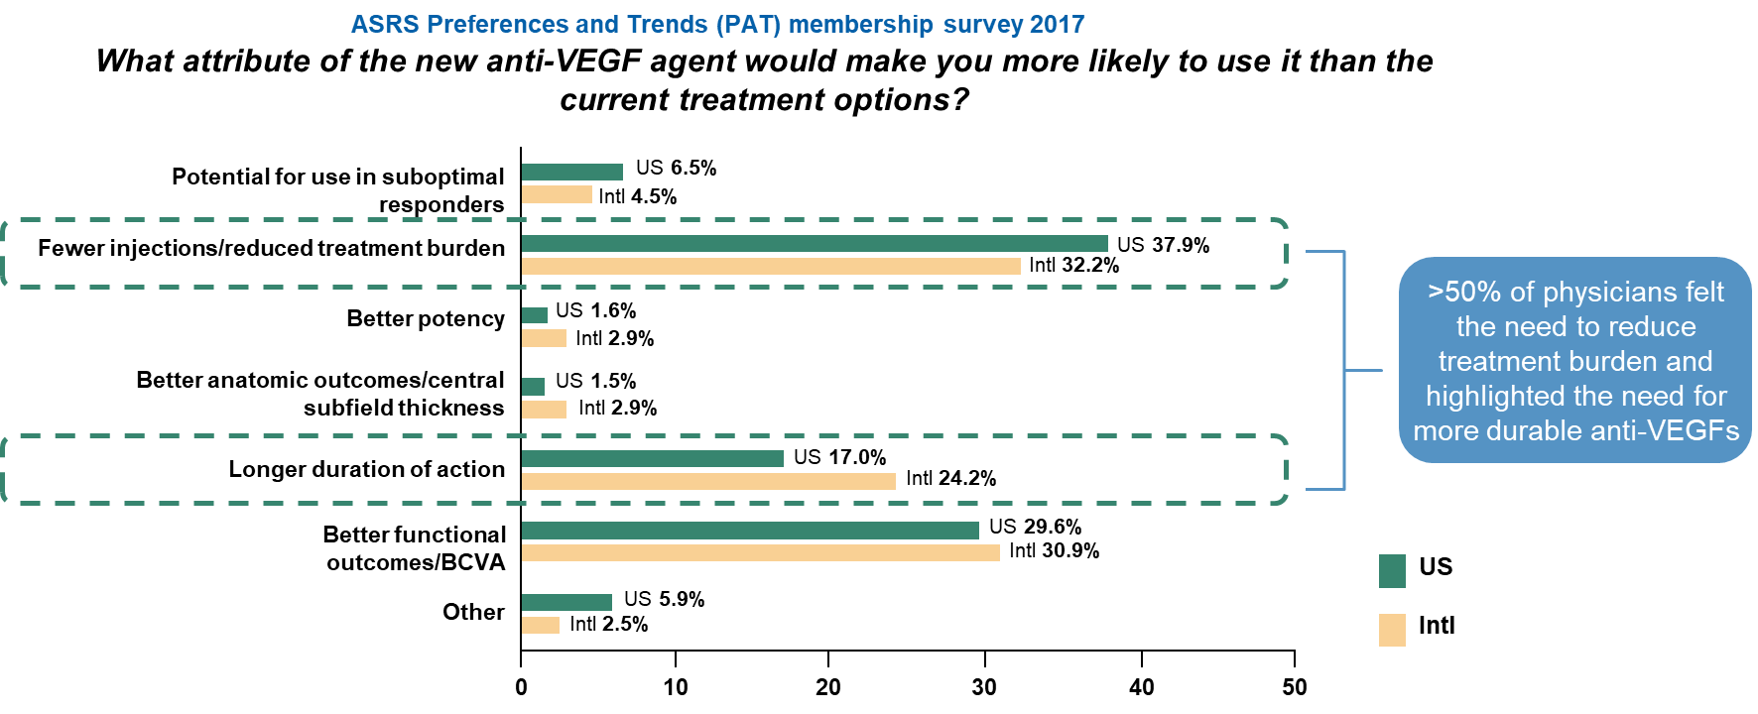
Physicians identify reduction in treatment burden as an unmet need with current anti-VEGFs
BCVA, best-corrected visual acuity; Intl, international; VEGF, vascular endothelial growth factor; US, United States. ASRS Preferences and Trends (PAT) membership survey 2017.
Notes:
031_ASRS survey 2017

Slide 21
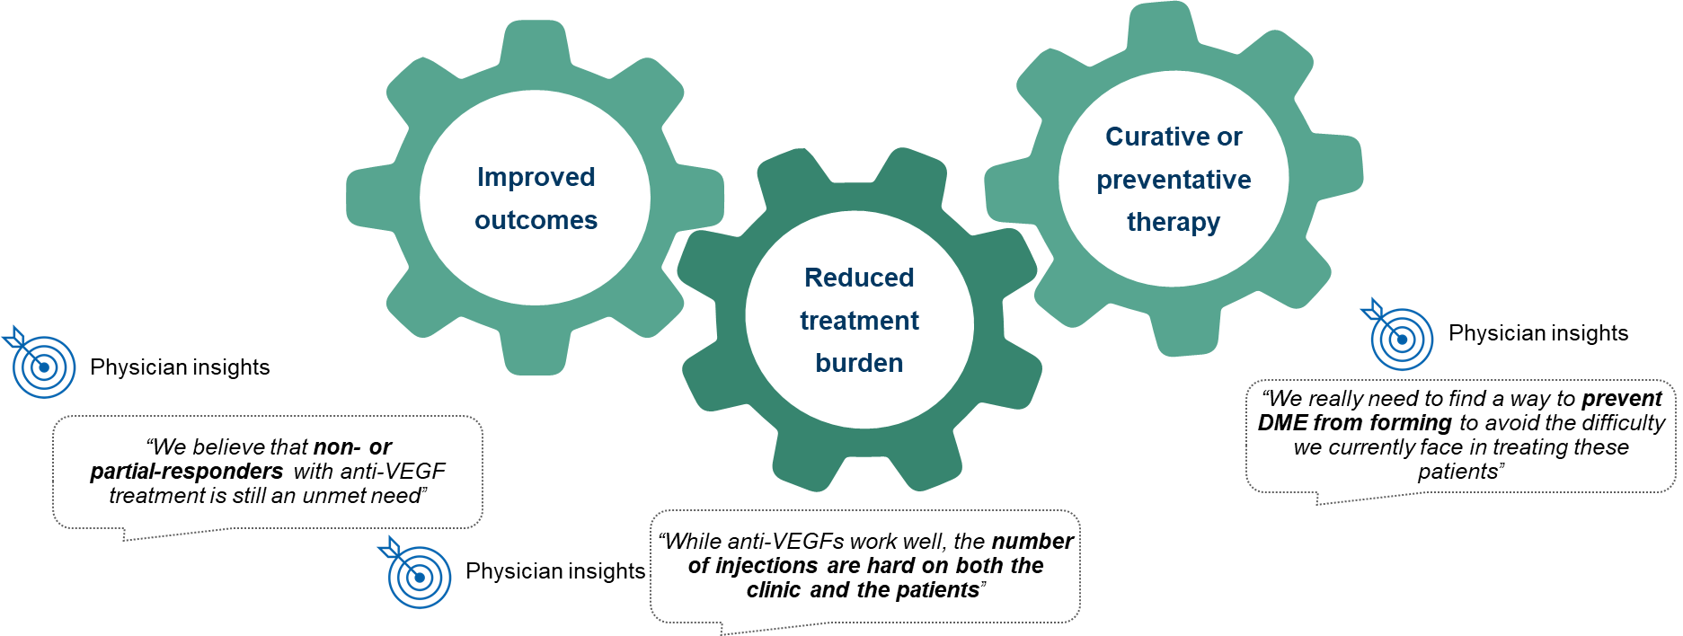
Improved outcomes and reduction in treatment burden identified as major unmet needs in DME
DME, diabetic macular edema; VEGF, vascular endothelial growth factor. Physician Interviews, Clear View Analysis 2017, and DME Advisory Board Insight 2019.

Slide 22
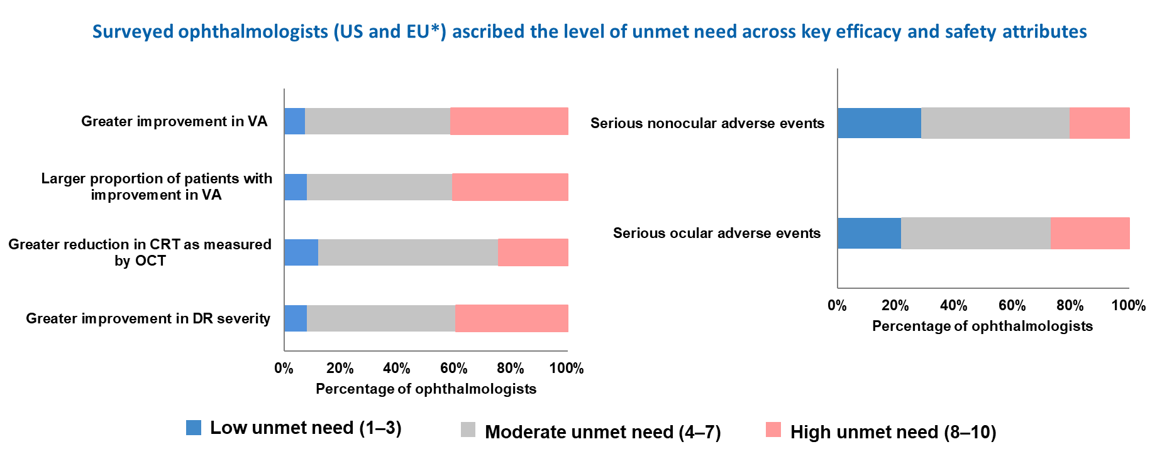
Physicians identify improved efficacy and safety as major unmet needs in DME
*Independent survey results from the US and EU (N=92; US=60, EU=32) presented as averaged data for the US and EU.
CRT, central retinal thickness; DME, diabetic macular edema; DR, diabetic retinopathy; EU, European Union; N, total number of patients; OCT, optical coherence tomography; US, United States; VA, visual acuity.
Available at :https://decisionresourcesgroup.com/report/unneop0003-biopharma-diabetic-macular-edema-diabetic-retinopathy
Notes:
032_US and EU survey results 2018

Slide 23
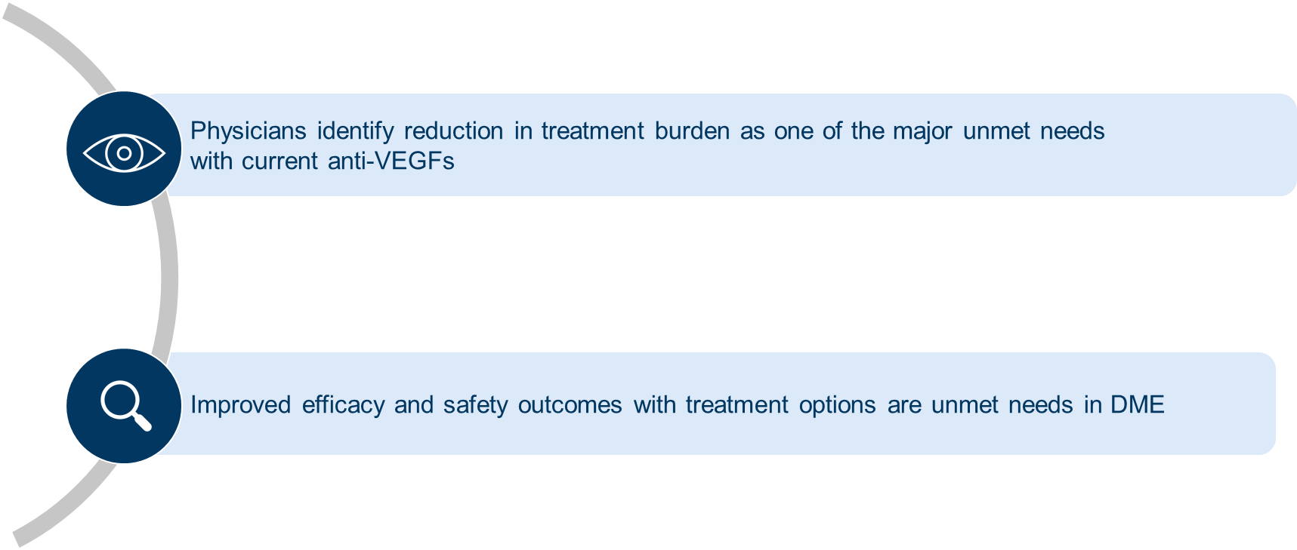
Summary
DME, diabetic macular edema; VEGF, vascular endothelial growth factor.

Slide 24
Healthcare system perspective

Slide 25
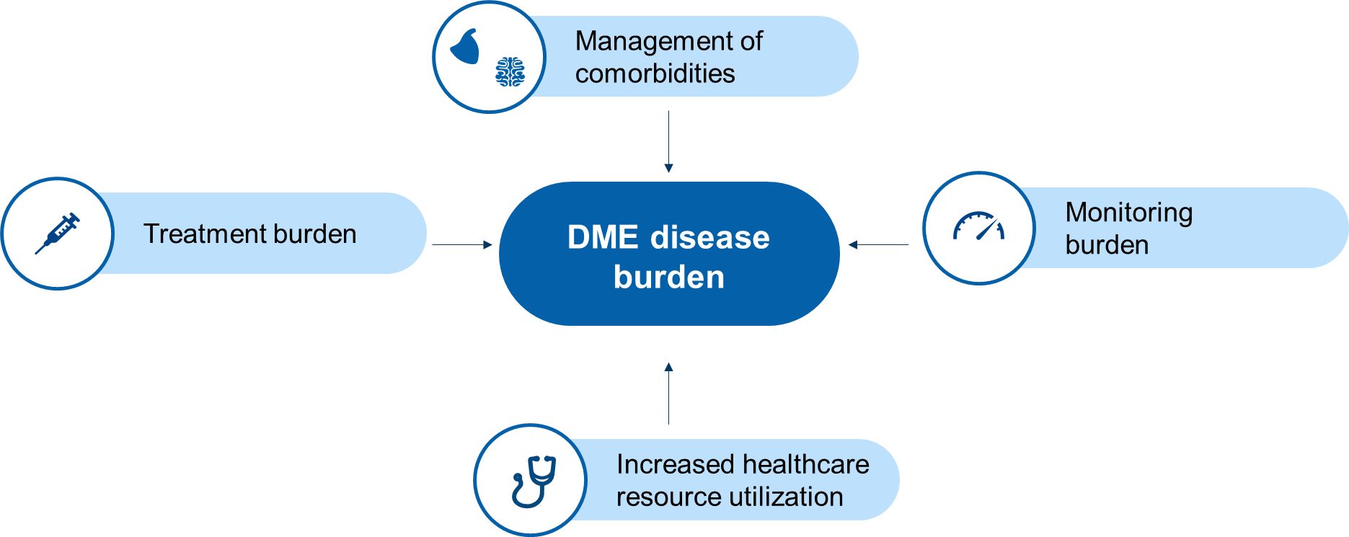
The DME disease burden on healthcare systems is multifactorial
DME, diabetic macular edema.

Slide 26
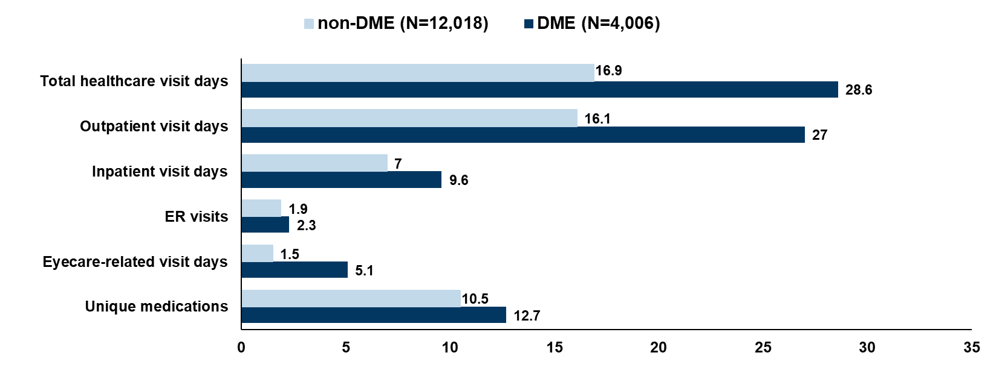
Significantly higher healthcare resource utilization in DME patients compared with non-DME patients
Matched cohort study: diabetic patients with DME (DME cases) versus diabetic patients without DME (non-DME diabetic controls) using the Truven Health MarketScan® Commercial Claims and Encounters Database (CCAE).
For all analyses for DME – P<0.001.
DME, diabetic macular edema; ER, emergency room; N, total number of patients. Kiss S, et al. Clinical Ophthalmol 2016;10:2443–53.
Notes:
033_Kiss S et al_2016

Slide 27
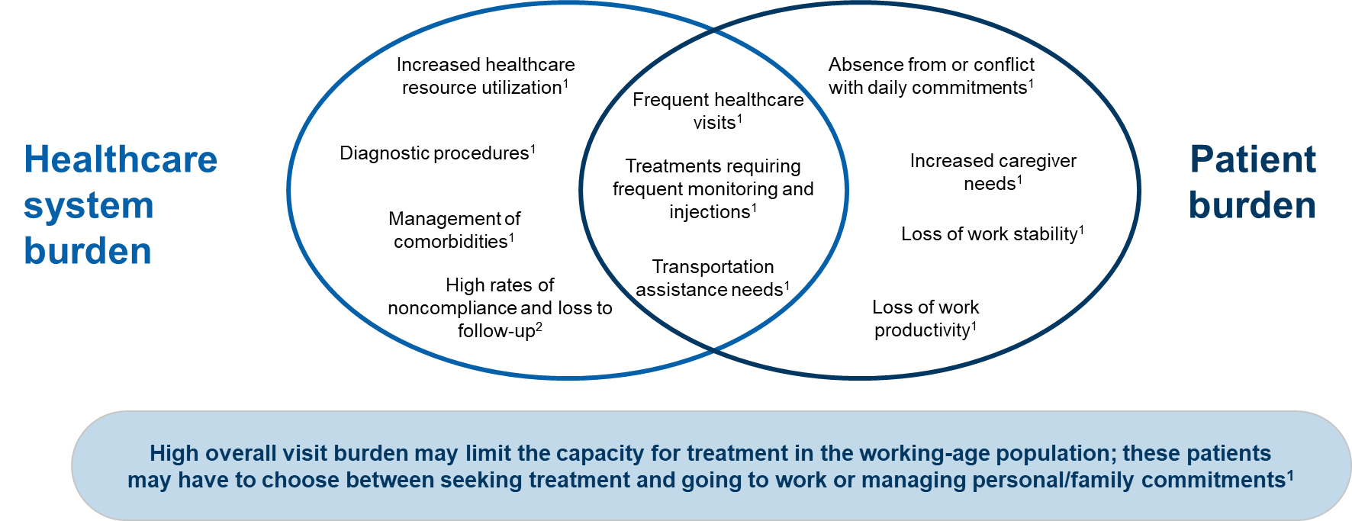
Treatment of DME confers substantial burden on patients and healthcare systems
DME, diabetic macular edema.
1. Kiss S, et al. Clinical Ophthalmol 2016;10:2443–53; 2. Angermann R, et al. Graefes Arch Clin Exp Ophthalmol 2019;257:2119–25.
Notes:
033_Kiss S et al_2016
034_Angermann R et al_2019

Slide 28
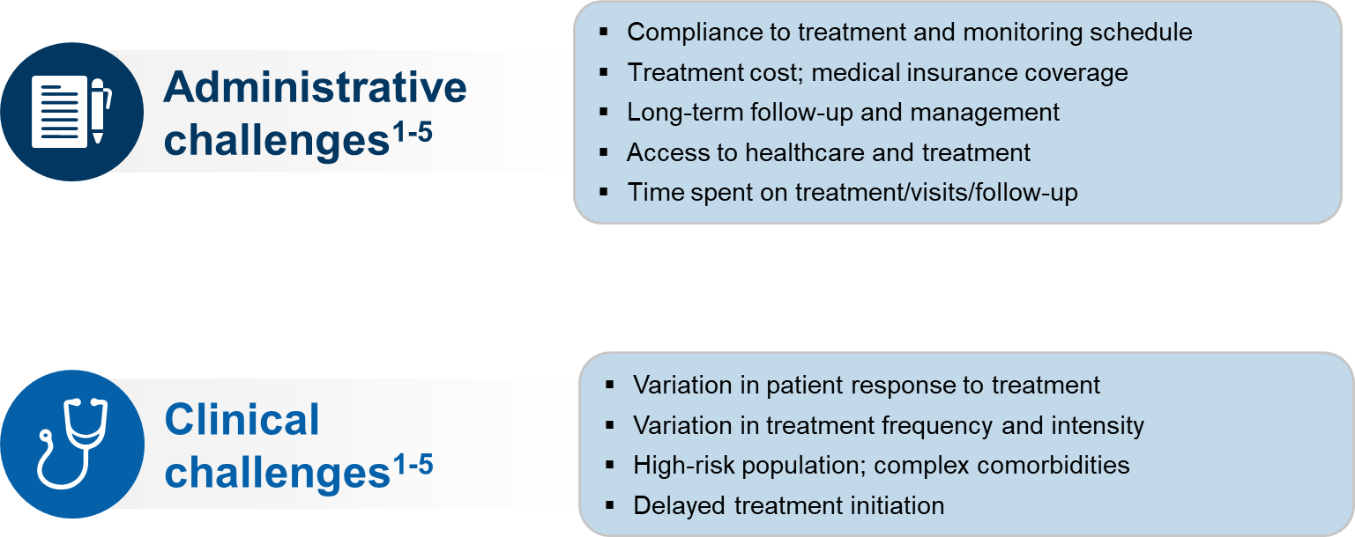
DME treatment is associated with a number of administrative and clinical challenges
DME, diabetic macular edema. 1. Wallick CJ, et al. Ophthalmic Surg Lasers Imaging Retina 2015;46:744–51; 2. Blinder KJ, et al. Clin Ophthalmol 2017;11:393–401; 3. Kiss S, et al. Clin Ophthalmol 2016;10:2443–53; 4. Ho M, et al. Retina 2016;36:432–8; 5. Jumper JM, et al. Clin Ophthalmol 2018;12:621–9.
Notes:
035_Wallick CJ et al_2015
036_Blinder KJ et al_2017
033_Kiss S et al_2016
037_Ho M et al_2016
038_Jumper JM et al_2018

Slide 29
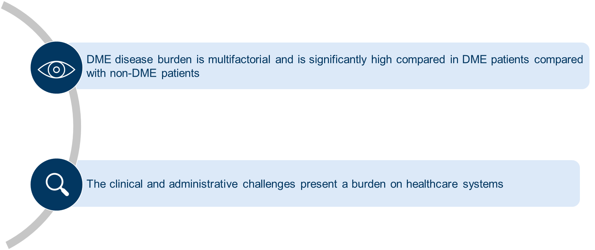
Summary
DME, diabetic macular edema.

Slide 30
Summary

Slide 31
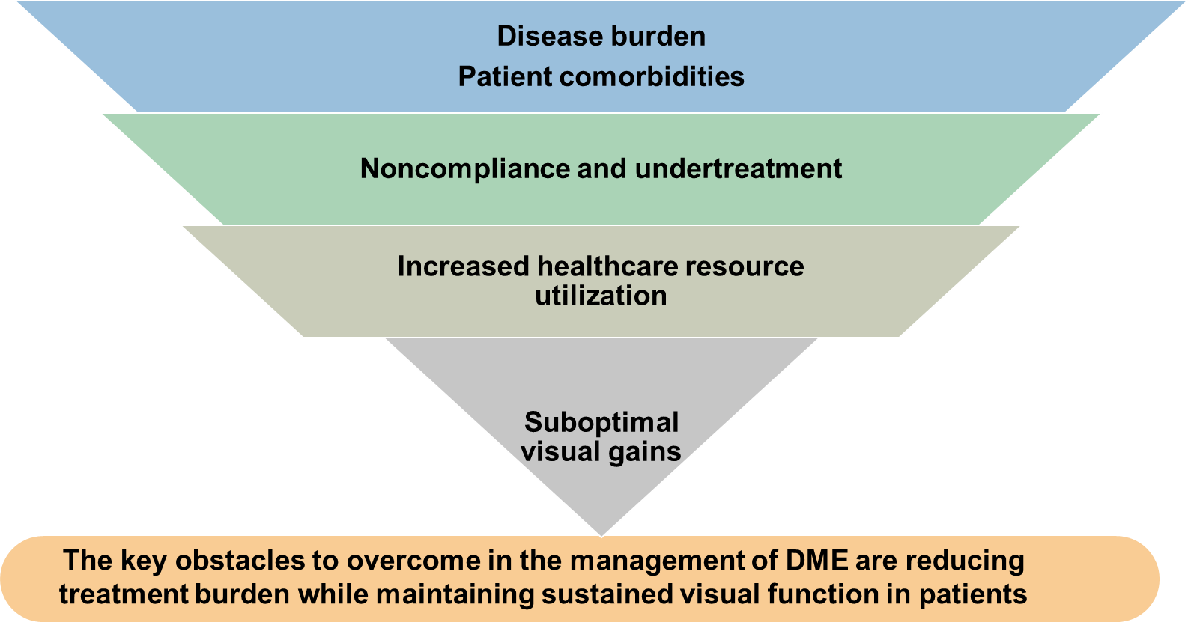
Multifactorial nature of DME treatment and unmet needs
DME, diabetic macular edema.

Slide 32
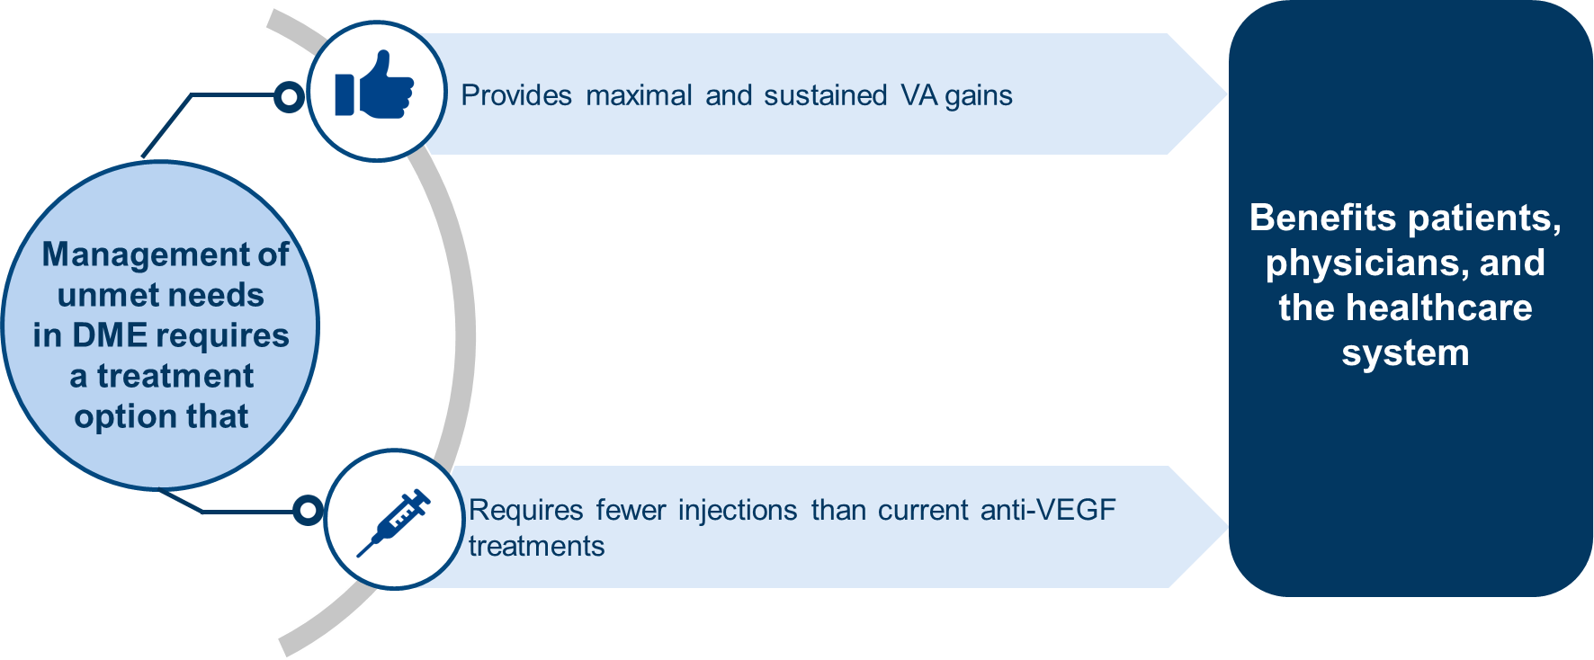
Summary
DME, diabetic macular edema; VA, visual acuity; VEGF, vascular endothelial growth factor.

